Slide 1
Clustering Techniques

Slide 2
Clustering
Clustering is a technique for finding similar groups in data, called clusters.
It groups data instances that are similar to (near) each other in one cluster and data instances that are very different (far away) from each other into different clusters.
A cluster is therefore a collection of objects which are “similar” between them and are “dissimilar” to the objects belonging to other clusters
How do we define “Similar” in clustering?
Note: Clustering is an unsupervised learning technique

Slide 3
Simple Clustering e.g.
Individuals | Price Conscious | Brand Loyalty
A | 2 | 4
B | 8 | 2
C | 9 | 3
D | 1 | 5
E | 8 | 1
From Scatter Plot we can see that
– A & D form one segment of customers who are very high on Brand Loyalty
6
5
Individuals
D
Brand Loyalty
4
A
– B, C, & E is another segment which is very Price Conscious
3
C
2
B
1
E
0
4 6
PriceConscious
0
2
8
10
Note: The above e.g. is just an hypothetical data to introduce the subject of clustering. It is not related to the below url:
http://globalbizresearch.org/chennai_conference/pdf/pdf/ID_C405_Formatted.pdf

Slide 4
Steps involved in Clustering Analysis
Formulate the problem – Select variables to be used for clustering
Decide the Clustering Procedure (Hierarchical / Non-Hierarchical)
Select the measure of similarity (dis-similarity)
Choose clustering algorithm (applicable in hierarchicalclustering)
Decide on the number of clusters
Interpret the cluster output (Profile the clusters)
Validate the clusters

Slide 5
Formulate the clustering problem
Formulate the problem
understand the business problem
hypothesize variables that will help solve the clustering
problem at hand
Applications of Clustering Technique
Store Clustering
Customer Clustering
Village Affluency Categorization
Note: It is preferable to do Factor Analysis / Principal Component Analysis before clustering

Slide 6
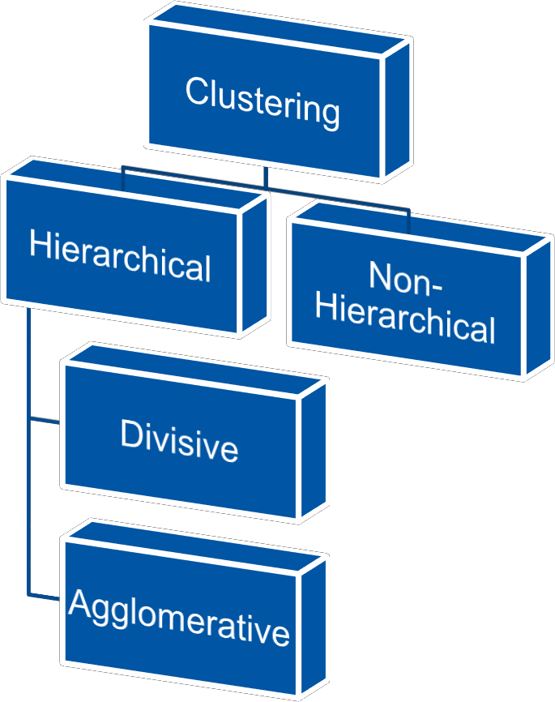
Decide the clustering procedure
Types of Clustering Procedures
Hierarchical Clustering
Non-Hierarchical Clustering
Hierarchical clustering is characterized by a tree like structure and uses distance as a measure of (dis)similarity
Non-hierarchical clustering techniques uses partitioning methods and within cluster variance as a measure to form homogeneous groups

Slide 7
Hierarchical Vs. Non-Hierarchical clustering
Hierarchical Clustering
Relatively very slower
Agglomerative clustering is not that widely used algorithm
Uses distance as a measurefor (dis)similarity
Helps suggest optimal numbersof clusters in data.
Object assigned to a cluster remainsin that cluster
Non-Hierarchical Clustering
Fast and preferable to usewith large
datasets
K-means is a very popular non-
hierarchical clustering technique
Uses within cluster varianceas a
measure of similarity
Non-hierarchical clustering require number of clusters as an input parameter for starting
Objects can be reassigned to other clusters during the clustering process

Slide 8
Hierarchical Clustering

Slide 9
Hierarchical Clustering - (dis)similarity measure
Hierarchical Clustering is based on dis(similarity) measure
Most software package calculate a measure of dissimilarity by estimating the distance between pair of objects
Objects with shorter distance are considered similar, whereas objects with larger distance are dissimilar
Measures of similarity
Euclidean distance (most commonly used)
City Block or Manhattan distance
Chebyshev distance

Slide 10
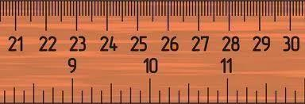
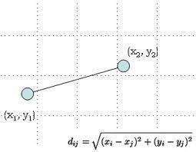
Distance Computation
A
B
What is the distance between
Point A and B?
Ans: 7
What is the distance between Point A and B?
B
A
Ans: √ [(x2-x1)² +(y2-y1)²]
(Remember the PythagorasTheorem)

Slide 11
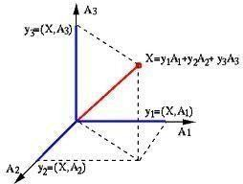
Distance Computation Contd…
What is the distance between Point A and B in n-Dimension Space?
If A (a₁, a₂, … a_{n}) and B (b₁, b₂, … b_{n}) are cartesian coordinates
By using Euclidean Distance (which is an extension of
Pythagoras Theorem), we get Distance AB as
D_{AB} = √ [(a₁-b₁)² + (a₂-b₂)² +….+ (a_{n}-b_{n})²]

Slide 12
Chebyshev Distance
In mathematics, Chebyshev distance is a metric defined on a vector space where the distance between two vectors is the greatest of their differences along any coordinate dimension
Assume two vectors:A (a₁, a₂, … a_{n}) & B (b₁, b₂, … b_{n})
Chebyshev Distance
= Max ( | a₁ - b₁ | , | a₂ - b₂ | , ….. | a_{n} - b_{n} | )
Application: Survey / Research Data where the responses are Ordinal
https://en.wikipedia.org/wiki/Chebyshev_distance

Slide 13
Manhattan Distance
Manhattan Distance also called City Block Distance
Assume two vectors: A (x1, x2, …xn) & B (y1, y2,…yn)
Manhattan Distance
= | a₁ - b₁ | + | a₂ - b₂ | +….. | a_{n} - b_{n} |
A
Block
Manhattan Distance = 8 + 4 = 12
Block
Chebyshev Distance = Max (8, 4) = 8
Block
Eucledian Distance = sqrt ( 8^2 + 4^2) = 8.94
Block
Block
Block
Block
Block
Block
Block
Block
B

Slide 14
Hierarchical Clustering | Agglomerative Clustering
Starts with each record as a cluster
of one record each
Sequentially merges 2 closest records by distance as a measure of (dis)similarity to form a cluster. This reduces the number of records by 1
Repeat the above step with new cluster and all remaining clusters till we have one big cluster
Step Step Step Step
1 2 3 4
a b
a b c d e
c d e
d e
How do you measure the distance between cluster (a,b) and (c) orthe cluster (a,b) and (d,e)
????
Step 0
a b
c
d e

Slide 15
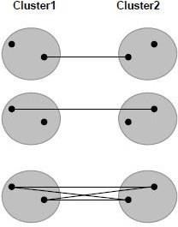
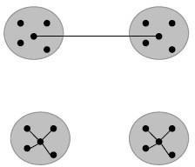
Agglomerative Clustering Procedures
Single linkage – Minimum distance or Nearest neighbour rule
Complete linkage – Maximum
distance or Farthest distance
Average linkage – Average of the distances between all pairs
Centroid method – combine cluster with minimum distance between the centroids of the two clusters
Ward’s method – Combineclusters with which the increase in within cluster variance is to the smallest degree
http://sites.stat.psu.edu/~ajw13/stat505/fa06/19_cluster/09_cluster_wards.html

Slide 16
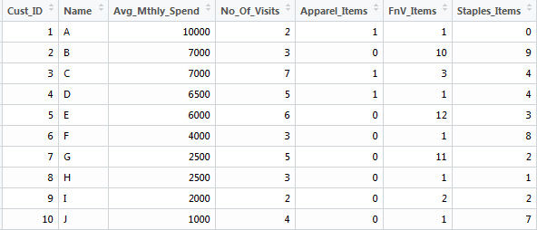
Clustering e.g. 1 : Clustering for Retail Customers
## Let us find the clusters in given Retail Customer Spends data
## We will use Hierarchical Clustering technique
## Let us first set the working directory path and import the data
RCDF <- pd.read_csv("datafiles/Cust_Spend_Data.csv", header=TRUE) View(RCDF)
HyperMarket CustomerSpend
Data - Metatdata
AVG_Mthly_Spend: The average monthly amount spent by customer
No_of_Visits: The number of times
a customer visited the HyperMarketi
Count of Apparel, Fruits and Vegetable, Staple Items purchased in a month

Slide 17
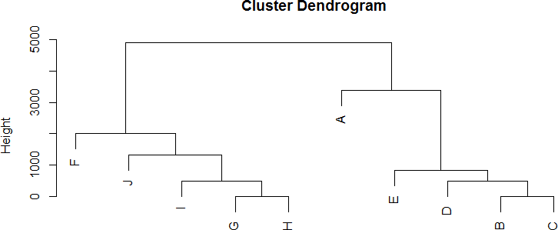
Building the hierarchical clusters (without variablescaling)
Dendogram looks like Decision Tree but its not s Tree
or classification
Note: The two clustersformed are primarily on the basis of AVG_MTHLY_SPEND
Eucledian Distance computation in this case is influenced by AVG_MTHLY_SPEND variable as the range of this variable is too large compared to the other variables
To avoid this problem, we should scale the variables used for clustering

Slide 18
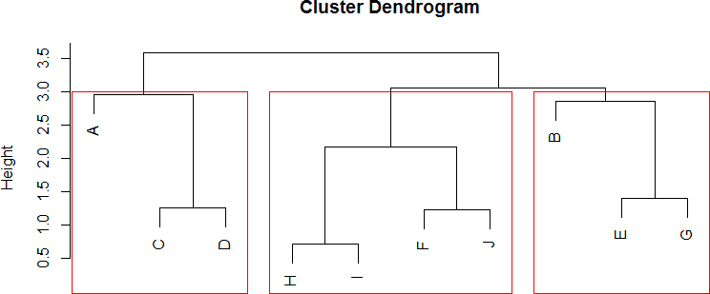
Building the hierarchical clusters (with variablescaling)
## scale function standardizes the values
Scaling of features can change the shape and sizes of the clusters. It can even generate various numbers of clusters.

Slide 19

Profiling the clusters
## profiling the clusters
Profiling of clusters means the aggregation of the patterns identified within the each cluster.
Also, The characteristics of the clusters

Slide 20
Non-Hierarchical Clustering (K Means)

Slide 21
K Means Clustering
K-Means is the most used, non-hierarchical clustering technique
It is not based on Distance…
It is based on within cluster Variation, in other words
Squared Distance from the Centre of the Cluster
The algorithm aims at segmenting data such that within cluster variation is reduced

Slide 22
K Means Algorithm
Input Required : No of Clusters to be formed. (Say K)
Steps
Assume K Centroids (for K Clusters)
Compute Eucledian distance of each objects with these Centroids.
Assign the objects to clusters with shortest distance
Compute the new centroid (mean) of each cluster based on the objects assigned to each clusters. The K number of means obtained will become the new centroids for each cluster
Repeat step 2 to 4 till there is convergence
i.e. there is no movement of objects from one cluster to another
Or threshold number of iterations haveoccurred

Slide 23
K-means advantages
K-means is superior technique compared to Hierarchical technique as it is less impacted by outliers
Computationally it is more faster compared to
Hierarchical
Preferable to use on interval or ratio-scaled data as it uses Eucledian distance… desirable to avoid using on ordinal data
Challenge – Number of clusters are to be pre-defined and to be provided as input to the process

Slide 24
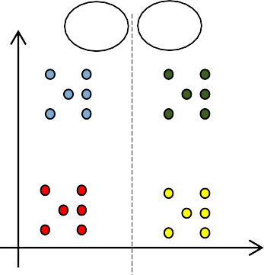
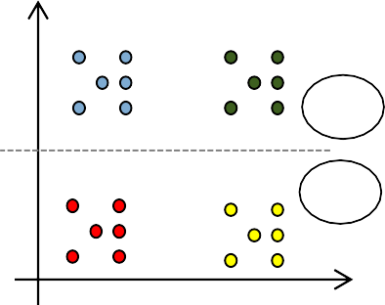
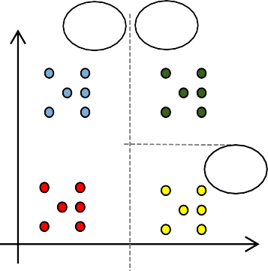
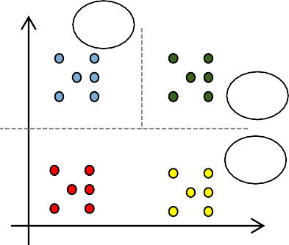
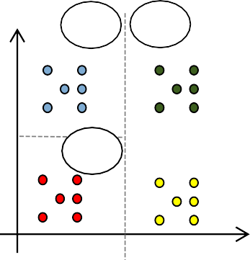
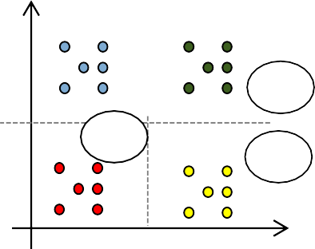
Why find optimal No. of Clusters?
Data to be clustered
Two Clusters – 2 possible solution
C1 C2
D2 D2
D2
C1
C2
D1
D1
D1
Three Clusters – Multiple possible solution
C1 C2
C3
C1 C2
D2
D2
D2
D2
C1
C1
C3
C2
C3
C3
C2
D1
D1
D1
D1

Slide 25
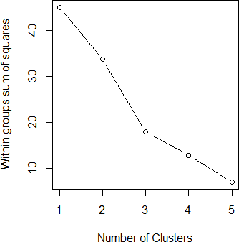
Optimal No. of Clusters
WSS Plot or Within Sum of Square Error Plot is used to identify the optimal number
of clusters.
WSS plot is also called as Scree Plot or Elbow Curve within the Analytics Industry. Elbow in the graph represents the optimal value of the clusters.

Slide 26
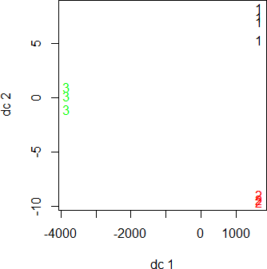
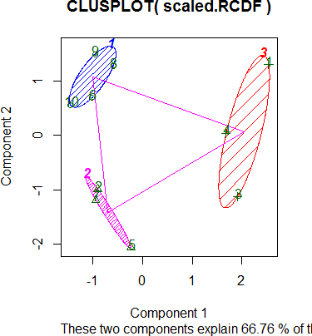
Plotting the clusters
## plotting the clusters
# More better plot

Slide 27

Profiling the clusters

Slide 28
Next steps after clustering
Clustering provides you with clusters in the given dataset
Clustering does not provide you rules to classify future records
To be able to classify future records you may do the following
Build Discriminant Model on Clustered Data
Build Classification Tree Model on Clustered Data

